Slide 1
Common Core State Standards & SBAC Field Test
Hill Regional Career High School
April, 2, 2014
Intended Outcomes:
To gain a general understanding of the new Common Core State Standards and the instructional shifts in ELA/Math
To understand how the SBAC Field Test will be administered at Career High School
To have an opportunity to ask questions and receive answers

Slide 2
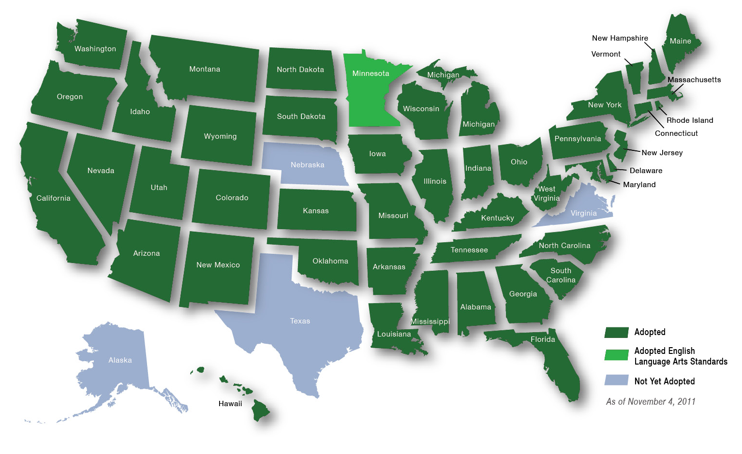
Common Core State Standards: Consistent Guidelines to Help Students Succeed
Define the knowledge and skills students need for college and career
Provide clear, consistent standards in English language arts/literacy and mathematics
Developed voluntarily and cooperatively by states; more than 40 states have adopted

Slide 3
Common Core State Standards
Why are they important?
Standards represent the skills students are expected to learn in each grade so that they graduate from high school capable of successfully completing first-year college courses
What does this mean for students?
Clear, rigorous expectations that will prepare students for college and career success
Deeper understanding of subject matters
New assessments will provide meaningful feedback to teachers and parents on how to help students succeed

Slide 4
ELA/Literacy: 3 Shifts The What
Building knowledge through content-rich nonfiction
Reading, writing, and speaking grounded in evidence from text, both literary and informational
Regular practice with complex text and its academic language

Slide 5
The Why: Shift One Building knowledge through content-rich nonfiction
Much of our knowledge base comes from informational text
Informational text makes up vast majority of required reading in college/workplace (80%)
Informational text harder for students to comprehend than narrative text
Yet students are asked to read very little of it in elementary (7 - 15%) and middle school
CCSS moves percentages to
50:50 at elementary level
75:25 at secondary level (includes ELA, science, social studies)

Slide 6
The Why: Shift Two Reading, writing & speaking grounded in evidence, both literary and informational
Most college and workplace writing is evidence-based and expository in nature (not narrative)
Ability to cite evidence differentiates student performance on NAEP
Standards in writing ask students to respond to evidence-based writing prompts (inform/argue)
Standards in speaking and listening require students to prepare for and refer to evidence on ideas under discussion
Standards in reading require students to respond to text-dependent questions with evidence-based claims

Slide 7
The Why: Shift Three Regular Practice with Complex Text and its Academic Language
Gap between complexity of college and high school texts is huge
What students can read, in terms of complexity is greatest predictor of success in college (ACT study)
Too many students reading at too low a level (<50% of graduates can read sufficiently complex texts)
Standards include a staircase of increasing text complexity from elementary through high school
Standards also focus on building vocabulary that is shared across many types of complex texts and many content areas

Slide 8
Mathematics: 3 Shifts The What
Focus: Focus strongly where the standards focus.
Coherence: Think across grades, and link to major topics
Rigor: In major topics, pursue conceptual understanding, procedural skill and fluency, and application

Slide 9
The Why: Shift One Focus strongly where the Standards focus
Significantly narrow the scope of content and deepen how time and energy is spent in the math classroom
Focus deeply only on what is emphasized in the standards, so that students gain strong foundations

Slide 10
Focusing attention within Number and Operations

Slide 11
The Why: Shift Two Coherence Think across grades, and link to major topics within grades
Carefully connect the learning within and across grades so that students can build new understanding onto foundations built in previous years.
Begin to count on solid conceptual understanding of core content and build on it. Each standard is not a new event, but an extension of previous learning.

Slide 12
Coherence: Think across grades
Fraction example:
“The coherence and sequential nature of mathematics dictate the foundational skills that are necessary for the learning of algebra. The most important foundational skill not presently developed appears to be proficiency with fractions (including decimals, percents, and negative fractions). The teaching of fractions must be acknowledged as critically important and improved before an increase in student achievement in algebra can be expected.”
Final Report of the National Mathematics Advisory Panel (2008, p. 18)

Slide 13
Coherence: Link to major topics within grades
Example: data representation
Standard 3.MD.3
3.MD, third cluster
Notes:
Instead of bar charts being “yet another thing to cover,” detracting from focus, the standard is telling you how to “aim” bar charts back around to the major work of the grade.

Slide 14
The Why: Shift Three Rigor In major topics, pursue conceptual understanding, procedural skill and fluency, and application
The CCSSM require a balance of:
Solid conceptual understanding
Procedural skill and fluency
Application of skills in problem solving situations
This requires equal intensity in time, activities, and resources in pursuit of all three

Slide 15
What is Smarter Balance Assessment Consortium? “SBAC”
Smarter Balance Assessment Consortium - SBAC
The company/organization that created and maintains the test
Will replace existing tests and are an improvement
CAPT testing in Science Only (2014 & 2015)
Provide an academic checkup by measuring real-world skills like critical thinking and problem solving
An adaptive computer testing system
Measures where students are on their path to success

Slide 16
What is the 2014 SBAC - Field Test?
A “Practice Run” of our new assessments
Helps ensure assessments are valid, reliable, and fair for all students
Provides teachers, schools, and students an opportunity to participate in a practice run of the assessment system
Evaluates performance of 20,000+ assessment items and performance tasks
Sets preliminary achievement standards that help track student preparedness for college and career

Slide 17
How is the Field Test administered?
All students in grade 11 will participate
Students tested in English (ELA) & Math
Test is not timed and will be taken on a computer.
Each student will be tested in 7 sessions for a total of approximately 7.5 hours.
4 Sessions of ELA including a Classroom Activity & Performance Task
3 Sessions of Math including a Classroom Activity & Performance Task
Because the Field Test is a “test of the test” that will result in some questions being revised or dropped, students will not receive scores.

Slide 18
When and how will the SBAC be administered at Career High School?
10 testing dates starting on May 19
5/19, 5/20, 5/21, 5/22, 5/29, 5/30, 6/2, 6/3, 6/4, 6/5
Each student will attend 7 testing sessions.
11th grade students will take the SBAC exam during their English and History courses.
Students will not miss any other academic courses.
All testing will take place in the library.
Accommodations for students with an IEP or 504 plan will be embedded into the tests.
SBAC testing will not be used for an academic grade and is not a currently a graduation requirement.

Slide 19
How can I support my child during SBAC testing?
Encourage your child to:
Attend school on time each day
Eat breakfast
Take the test seriously
Don’t stress, just do your best
Ask test related questions to any administrator

Slide 20
Learn More and Stay Engaged
For More Information, Visit: http://sbac.portal.airast.org/ or Google “SBAC”
To Experience the Assessment Yourself, Take the Practice or Training Test: SmarterBalanced.org/practice-test/

